Slide 1
An Introduction to Web Crawling
40% of web traffic is due to web crawlers!

Slide 2
Web Crawler
A web spider crawls content on websites
It builds an index for a search engine
Search algorithms rank the most relevant pages
Also, one needs to bear in mind two essential points:
You do not do your searches in real-time as it is impossible
You do not do your searches in the World Wide Web

Slide 3
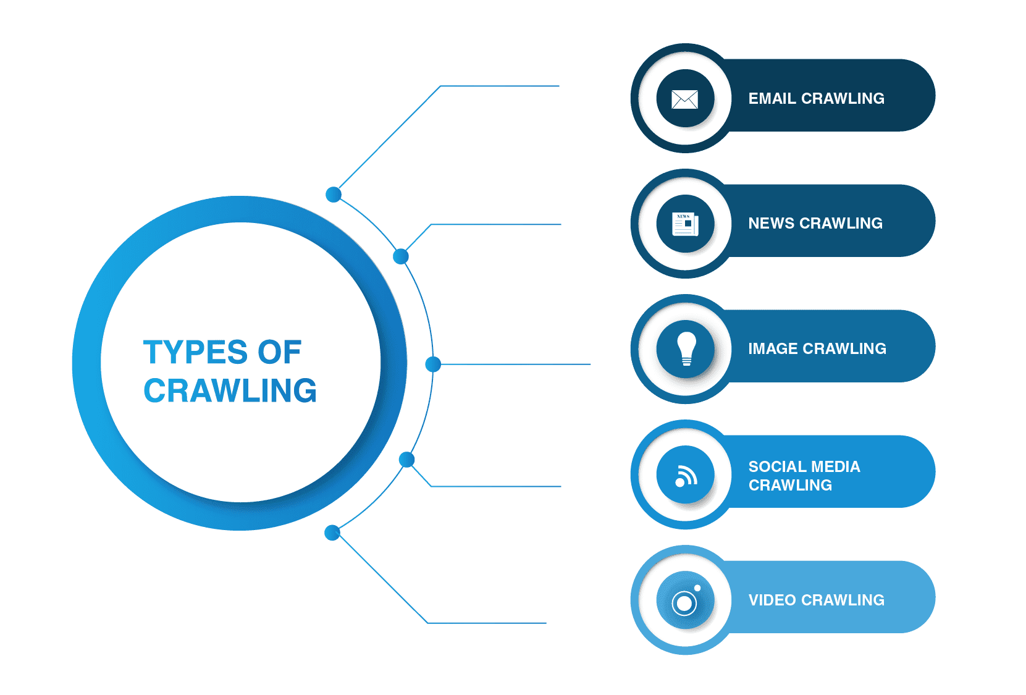
Types of Crawling

Slide 4
Content
Aggregators
Web
Web Archives
Visit https://archive.org/about/
Web Crawler
(a.k.a. bot or spider)
Web Monitoring
Services
Downloads the web content
… more apps …
Search Engines

Slide 5





The Role of Content Aggregators
Source 1
Source 1 …
Source n
Content
Aggregator
Pulls content based on tag, author, topic, etc.
User
There are many content aggregation websites… Some have curated content, and some not.

Slide 6
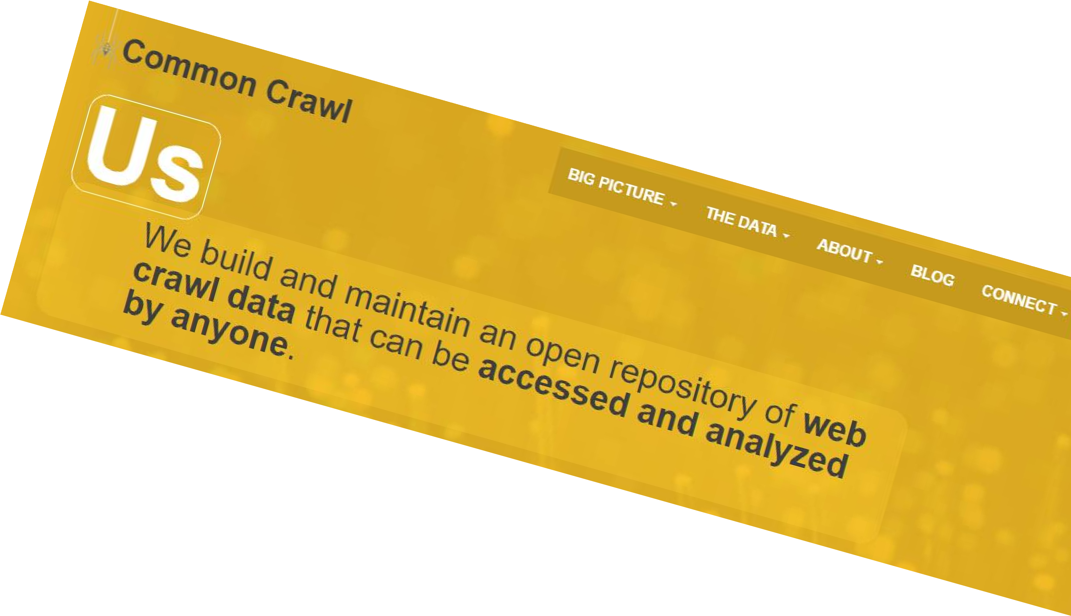
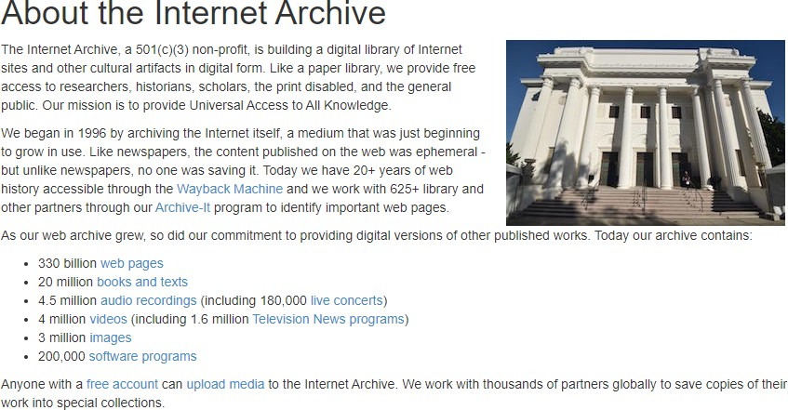
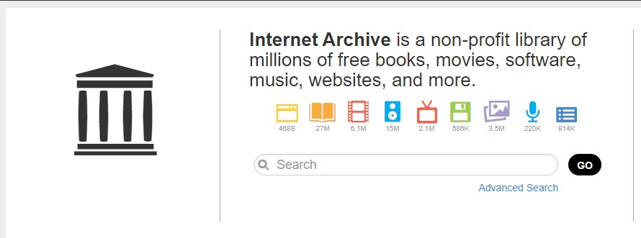
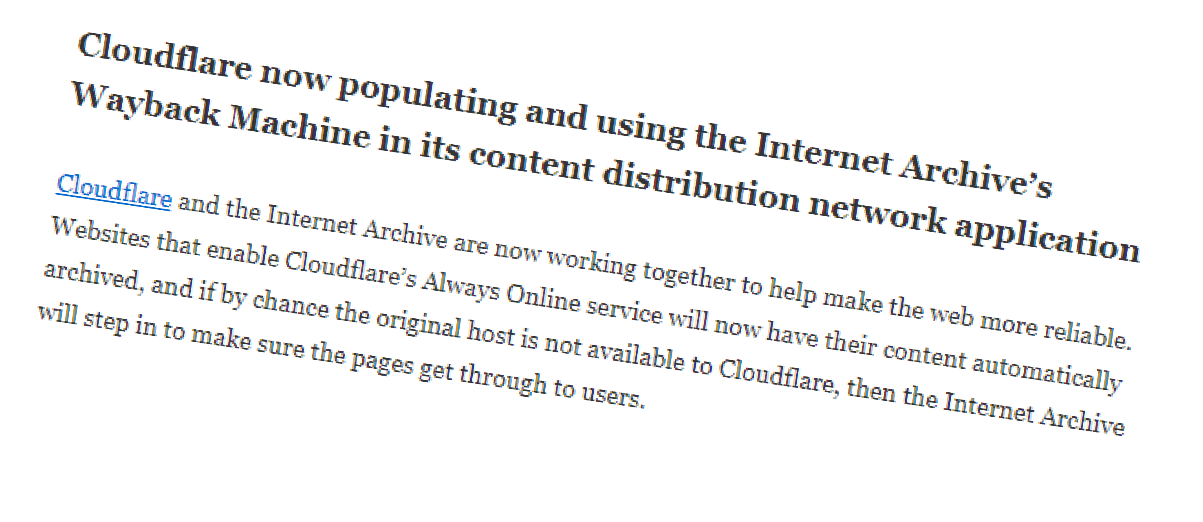
Web Archives
See https://archive.org/about/ https://commoncrawl.org/

Slide 7
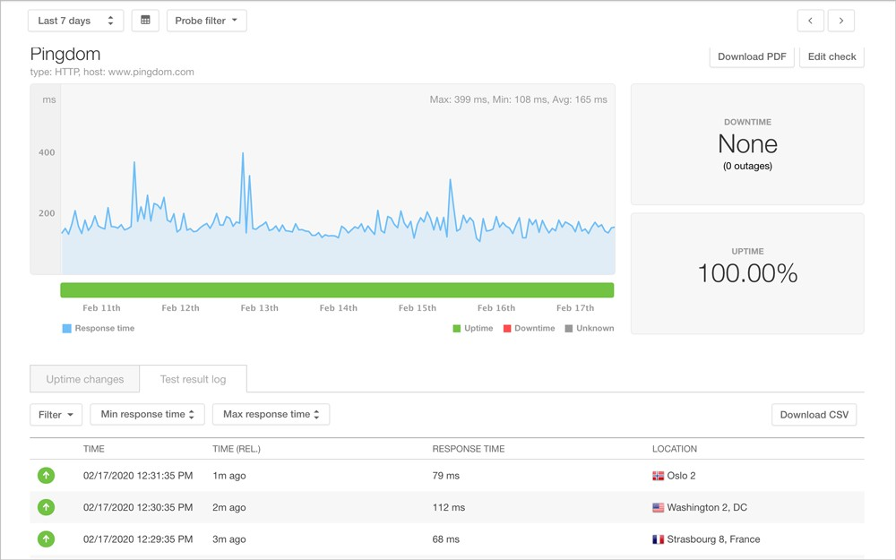



Web Monitoring Services
Does your web host provide 99.99% uptime? Really?
Many services are available over the web to check.

Slide 8




When was the page last updated?
Does the site owner want this page “not” to be searchable?
Are there more related pages on the site?
What meta-information would a crawler like to know about a page?
Importance of
the page
How frequently does the page get updated?
Some of these are readily available in the page “HEAD”er, or on the sitemap.xml.

Slide 9
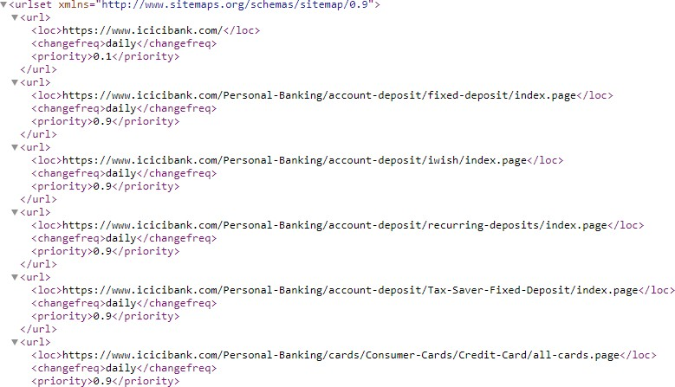
Sitemaps

Slide 10
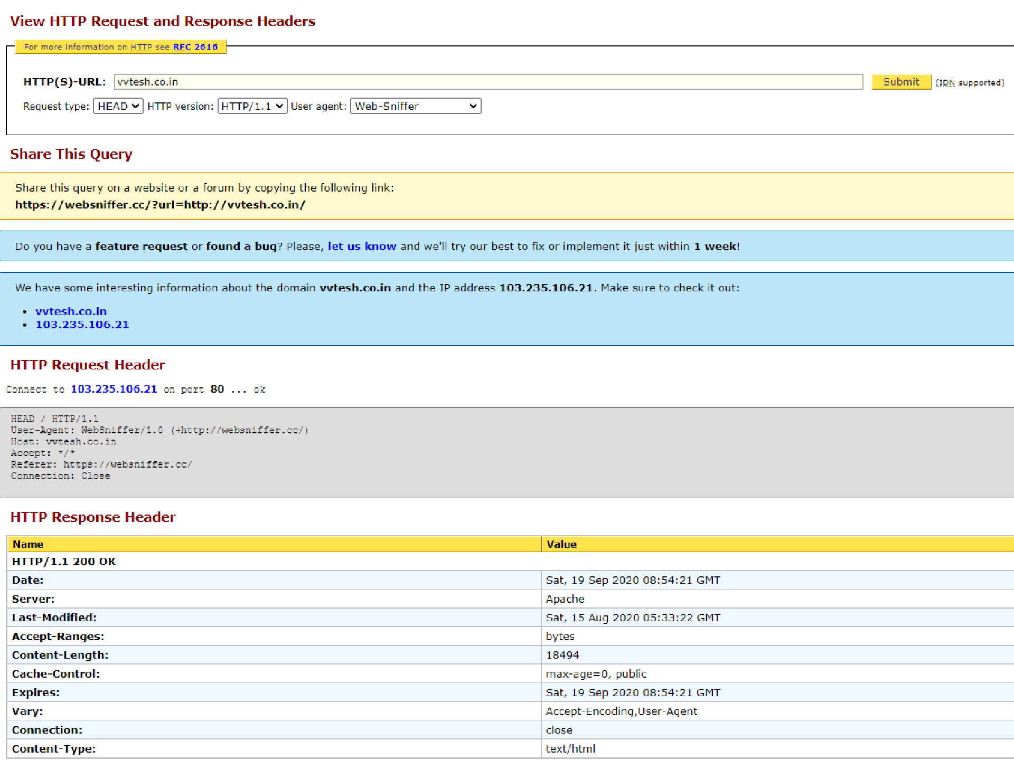

Slide 11

Robots.txt
identifies a crawler. * refers to all crawlers.
Do not crawl these pages
User-agent: *
Disallow: /yoursite/temp/
“searchengine” crawler may crawl everything!
User-agent: searchengine
Disallow:
Site owner may add a robots.txt file to request
the bots “not” to crawl certain pages.

Slide 12
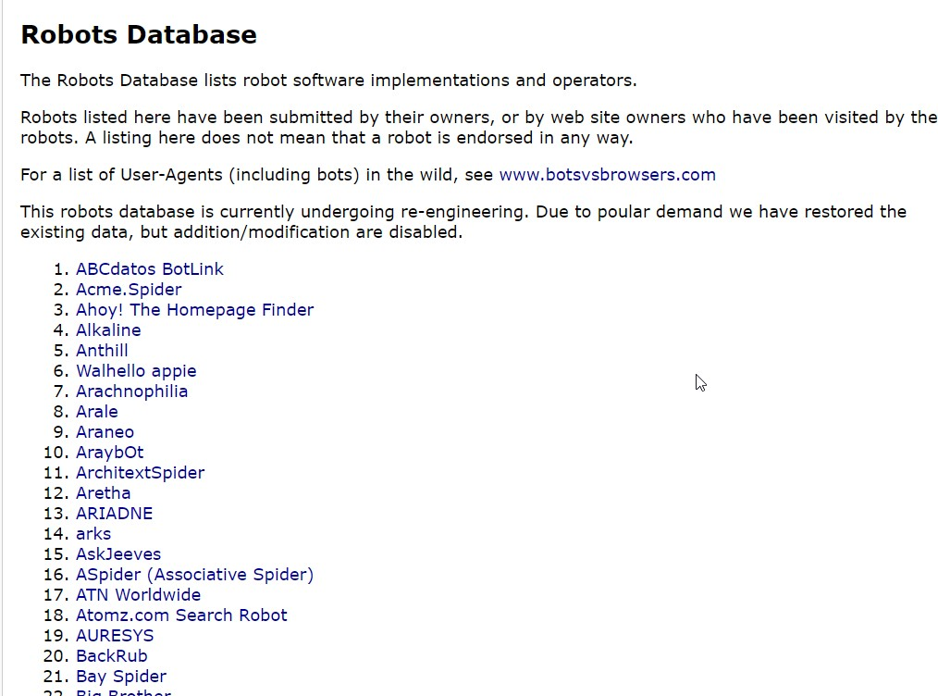
How Many Bots Exist?

Slide 13
History
First Generation Crawlers
WWW Wanderer – Matthew Gray – 1993
Written in Perl.
Worked out of a single machine.
Fed the index, the Wandex, thus contributing to the first search engine of the world.
MOMSpider
First polite crawler (rate of requests limited per domain).
Introduced “black list” to avoid crawling few sites.
Several followed: RBSESpider, WebCrawler, Lycos Crawler, Infoseek, Excite, AltaVista, and HotBot.
Brin and Page’s Google Crawler – 1998
Implemented with Python, asynchronous I/O, 300 downloads in
parallel, 100 pages per second.
https://www.robotstxt.org/db/momspider.html
A Robots DB is here (https://www.robotstxt.org/db.html)

Slide 14
History
Second Generation Crawlers (Scalable Versions)
Mercator - 2001
891 Million pages in 17 days
Polybot
Introduced URL-Frontier (idea of seen-URLs set)
IBM WebFountain
Multi-threaded processes called Ants to crawl.
Applied Near-duplicate detection to reject webpages.
Central controller for scheduling tasks to Ants.
C++ and MPI (Message Passing Interface) based. Used 48 machines to crawl.
Several followed: UbiCrawler, IRLbot.
Open Source Crawlers
Heritrix
Nutch.

Slide 15
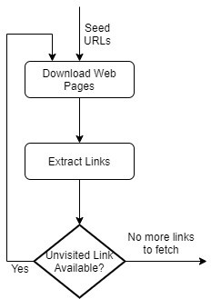
A Basic Crawl Algorithm
Few (10 or 100) web pages known apriori to be high- quality (popular)
Source: Web Crawling, Christopher Olston and Marc Najork, Foundations and Trends in Information Retrieval, Vol. 4, No. 3 (2010) 175–246

Slide 16
Challenges
Scale
Can I get high value
content quickly?
Coverage Vs. Freshness
Higher coverage => Higher Crawl Time => Lesser Freshness.
How to be fair?
Beware of adversaries
Fake Websites
Crawler Traps
Source: Web Crawling, Christopher Olston and Marc Najork, Foundations and Trends in Information Retrieval, Vol. 4, No. 3 (2010) 175–246

Slide 17
Scaling to Web
Caching
Cache IP addresses to avoid repeated DNS lookups.
Cache robots.txt files.
Avoid Fetching Duplicate Pages
Remember fetched URLs
Prioritize
For Freshness

Slide 18
A Scalable Crawl Architecture
Sec. 20.2.1
WWW
DNS
Parse
robots filters
URL
set
Fetch
Content seen?
URL
filter
Dup URL
elim
URL Frontier

Slide 19
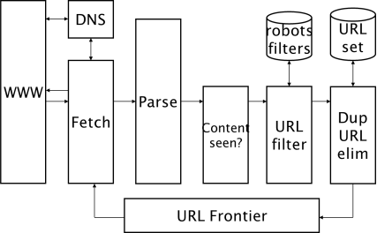
Data Structures
A queue of URLs per web site.
Allows throttling the access per site.
Dequeue an URL → Download the page →  Extract URLs → Add them to queue →  Iterate.
A bloom filter to avoid revisiting same URL.
- Bloom filter is a space-efficient probabilistic data structure that is used to test whether an element is a member of a set.
- it is space efficient and space constant.

Slide 20
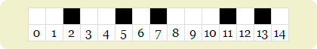
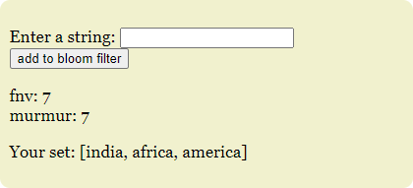
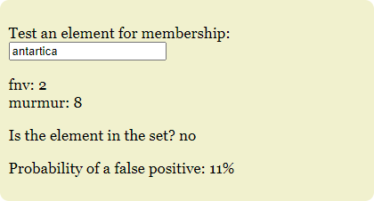
A Bloom Filter
https://llimllib.github.io/bloomfilter-tutorial

Slide 21
http://vvtesh.co.in http://www.vvtesh.co.in http://vvtesh.co.in/index.html http://www.vvtesh.co.in/index.html http://vvtesh.co.in/index.html?a=1 http://vvtesh.co.in/index.html?a=1&b=2
/index.html teaching/../index.html
…
Same page on the web can have
multiple URLs!
So, crawlers need to canonicalize the URLs.
You can help the crawler by identifying the canonical URL
<html>
<head>
<link rel="canonical" href="[canonical URL]">
</head>
</html>

Slide 22
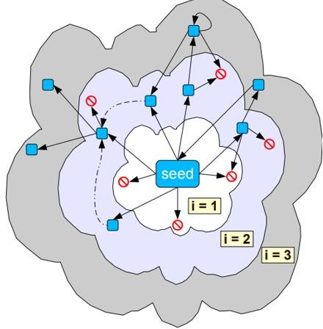
Frontier Expansion
Should we do Breadth-First or Depth-First Crawl?

Slide 23
How Frequently to Crawl?
Crawling the whole web every minute is not feasible.

Slide 24
Metrics and Terminology
is fresh if it hasn’t changed
after we crawled.
The page p₁
is stale if it changed after we crawled.
p₁
Freshness =
#𝑓𝑟𝑒𝑠ℎ
#𝑐𝑟𝑎𝑤𝑙𝑒𝑑
A Crawl
(refers to the pages p_{i} collected from one crawl over the web)
Fast changing websites bring freshness of our
crawl down!
Can we do better?

Slide 25
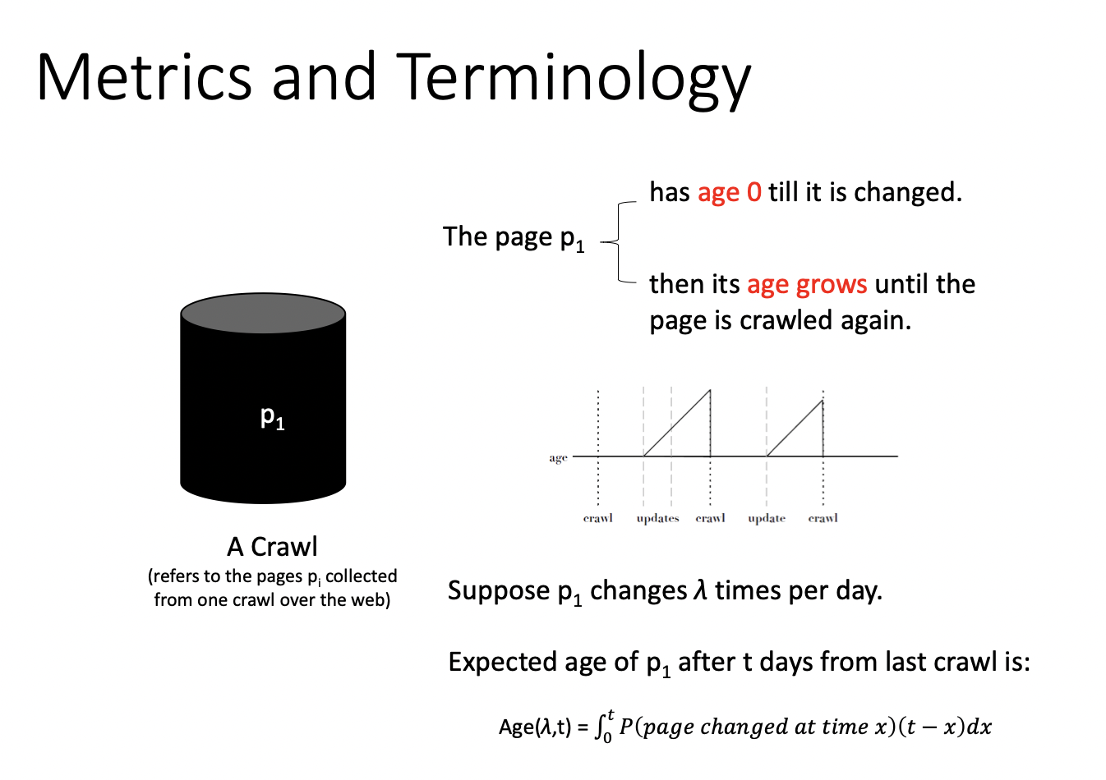

Slide 26
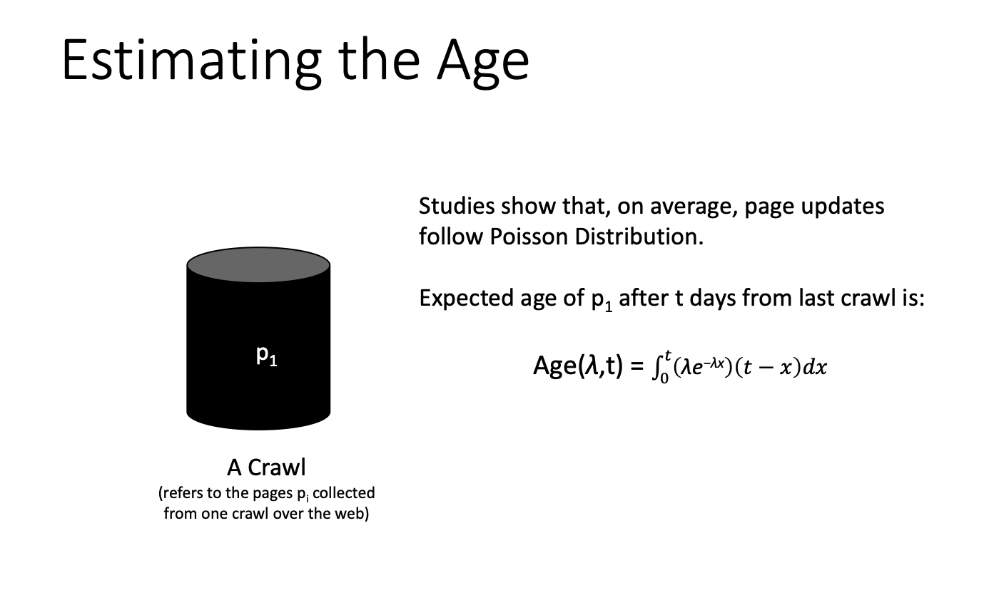

Slide 27
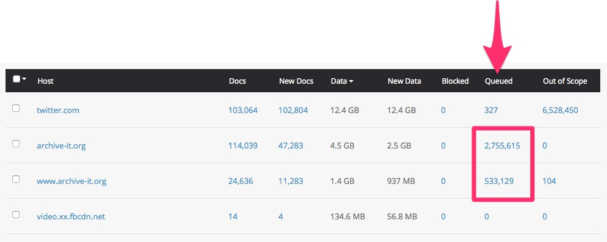
Crawler Traps
Websites can generate possibly infinite URLs!
Often setup by spammers
E.g., Dynamically redirect to infinitely deep directory structures like
http://example.com/bar/foo/bar/foo/bar/foo/bar
/...
Several ideas to counter this has been suggested
E.g., “Budget Enforcement with Anti-Spam Tactics” (BEAST)
https://support.archive-it.org/hc/en-us/articles/208332943-Identify-and-avoid-crawler-traps-

Slide 28
Batch Vs. Incremental Crawling
Incremental Crawling
Works with a base snapshot of the web.
Incrementally update the snapshot with new/ modified/ removed pages.
Works well for static web pages.
Batch Crawling
Easier to implement.
Works well for dynamic web pages.
Usually, we mix both.
Incremental Crawling, Kevin S. McCurley.

Slide 29
Distributed Crawling
Can we use cloud computing techniques to distribute the crawling task?
Yes! Modern search engines use several thousand computers to crawl the web.
Challenges
We don’t like multiple nodes to download the same URL, do the same DNS look-ups or parse the same HTML pages.
Solutions
Hash URLs to nodes.
Use central URL Frontier, caches and queues.
Read Cho and Garcia-Molina, Parallel Crawlers, WWW 2002.

Slide 30
Crawler in Python
Creating a new Scrapy project
Writing a spider to crawl a site and extract data
Exporting the scraped data
Changing spider to recursively follow links
Using spider arguments

Slide 31
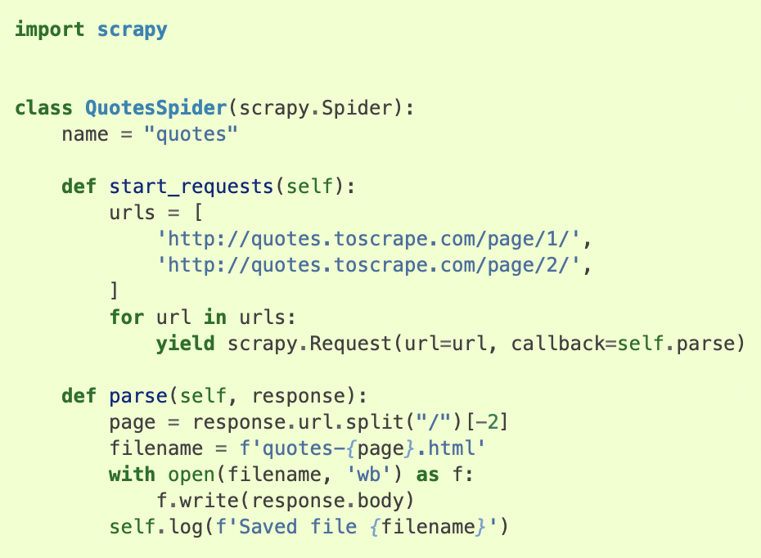

Slide 32
Summary
Scale
Can I get high value
content quickly?
Coverage Vs. Freshness
How to be fair?
Beware of adversaries

Slide 33
An Experiment
The Hardware
Intel Xeon E5 1630v3 4core 3.7 GHz
64 GB of RAM DDR4 ECC 2133 MHz
2x480GB RAID 0 SSD
Ubuntu 16.10 server
Nutch
11 Million URLs fetched in ~32 hours.
StormCrawler
38 Million URLs fetched in ~66 hours.
https://dzone.com/articles/the-battle-of-the-crawlers-apache-nutch-vs-stormcr

Slide 34
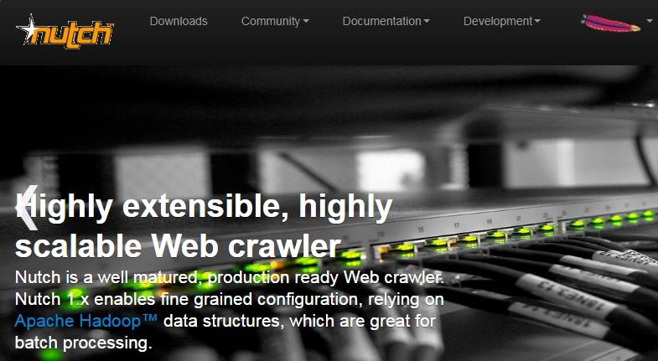
Apache Nutch
https://cwiki.apache.org/confluence/display/NUTCH/NutchTutorial

Slide 35
Using a Modern Crawler is Easy!
How do we crawl with Nutch?
Give a name to your agent. Add seed urls to a file.
Initialize the Nutch crawl db
Nutch inject urls/
Generate more URLs
Nutch generate –topN 100
Fetch the pages for those URLs
Nutch fetch –all
Parse them
Nutch parse –all
Update the db and index in solr
Nutch updatedb –all
nutch solrindex <solr-url> -all
Caution: I have dropped dedup and link inversion steps for simplicity.
https://cwiki.apache.org/confluence/display/NUTCH/NutchTutorial

Slide 36
Readings/Playlists
Berlin Buzzwords 2010 Talk on Nutch as a Web Mining Platform The Present & The Future
https://www.youtube.com/watch?v=fCtIHfQkUnY
Nutch Tutorial
https://cwiki.apache.org/confluence/display/NUTCH/Nu tchTutorial
Web Crawling, Christopher Olston and Marc Najork, Foundations and Trends in Information Retrieval, Vol. 4, No. 3 (2010) 175–246

